Slide 1
Customer Experience Management In E-Commerce Business
Name : C. RAMA DEVI
Department : CSE
Reg Number : 192111724
SlideMake.com

Slide 2
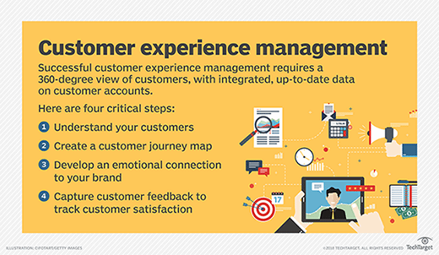
Introduction to Customer Experience Management in E-Commerce Business
Customer experience management is crucial for e-commerce businesses to build brand loyalty and increase customer retention.
Providing a seamless and personalized shopping experience can lead to higher conversion rates and customer satisfaction.
Effective customer experience management involves understanding customer needs and preferences.
Notes:
Image source: https://www.techtarget.com/searchcustomerexperience/definition/customer-experience-management-CEM-or-CXM

Slide 3

Understanding Customer Expectations in E-Commerce
Customers expect a user-friendly website with easy navigation and quick loading times.
Personalized product recommendations based on browsing history and purchase behavior enhance the shopping experience.
Prompt and efficient customer support through multiple channels such as live chat and email is essential.
Notes:
Image source: https://www.productsup.com/blog/2022-how-customer-expectations-are-changing-ecommerce/

Slide 4
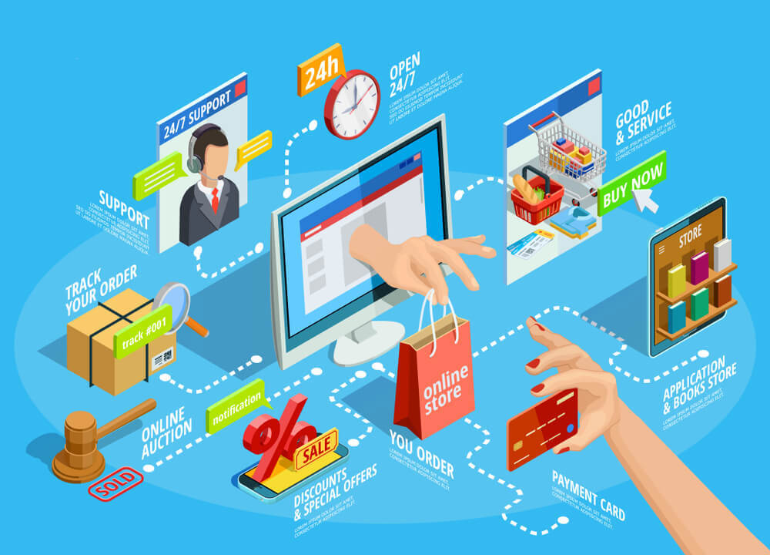
Importance of Omnichannel Experience in E-Commerce
Offering a seamless shopping experience across multiple channels, including desktop, mobile, and social media, is key to customer satisfaction.
Consistent branding and messaging across all channels help build trust and credibility with customers.
Integration of data and insights from different channels enables e-commerce businesses to provide a cohesive customer experience.
Notes:
Image source: https://christhompson.blog/2023/07/10/the-benefits-of-omnichannel-e-commerce-how-to-offer-a-seamless-shopping-experience/

Slide 5

Leveraging Data Analytics for Customer Insights
Data analytics tools help e-commerce businesses track customer behavior, preferences, and buying patterns.
Insights from data analysis can be used to tailor marketing campaigns, product recommendations, and personalized offers.
Utilizing data to personalize the customer experience can lead to increased engagement and higher conversion rates.
Notes:
Image source: https://www.cumanagement.com/articles/2022/09/leveraging-data-analytics-improve-member-service

Slide 6
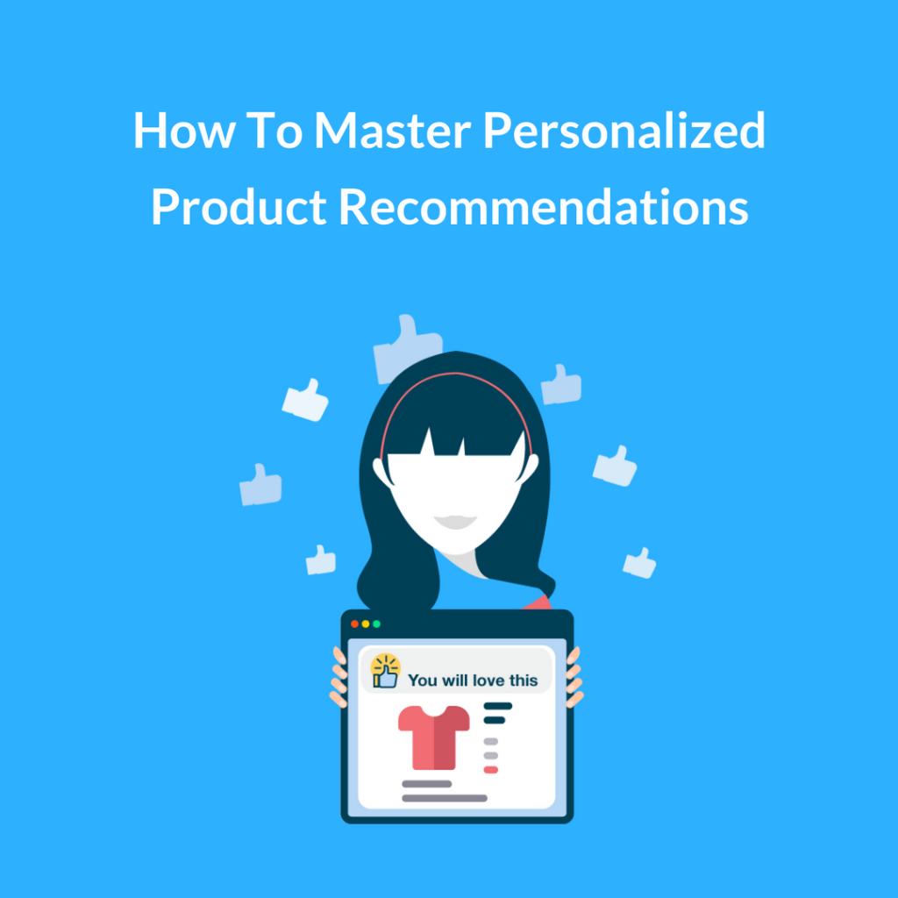
Implementing Personalization Strategies in E-Commerce
Personalizing product recommendations, email marketing, and website content based on customer preferences can enhance the shopping experience.
Utilizing AI and machine learning algorithms to deliver personalized experiences at scale can drive customer loyalty.
Dynamic pricing strategies and personalized promotions can incentivize repeat purchases and increase customer lifetime value.
Notes:
Image source: https://christhompson.blog/2023/12/01/the-science-of-product-recommendations-in-e-commerce-boosting-sales-with-personalized-suggestions/

Slide 7
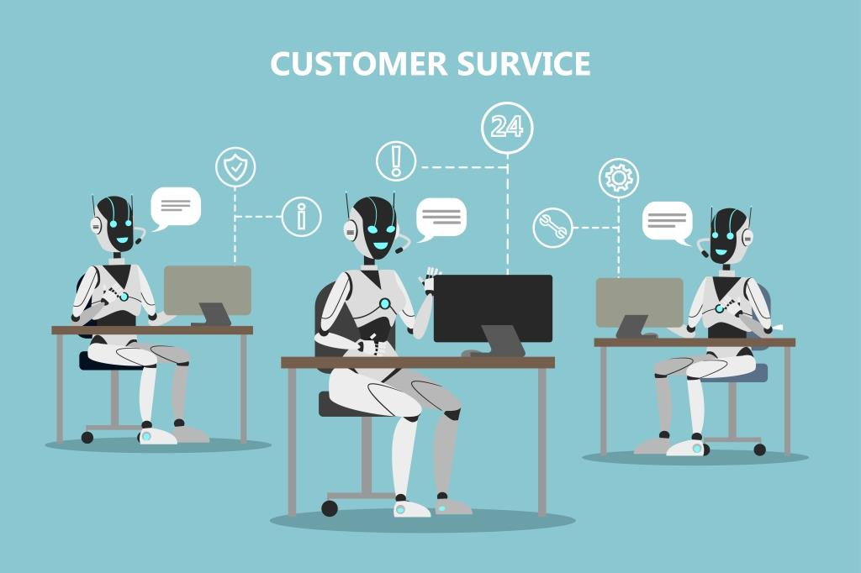
Enhancing Customer Service and Support in E-Commerce
Providing responsive and proactive customer support through chatbots, self-service options, and human agents improves customer satisfaction.
Offering hassle-free returns, exchanges, and refunds policies can build trust and loyalty with customers.
Monitoring customer feedback and reviews to address issues promptly and improve overall customer experience.
Notes:
Image source: http://catalystforbusiness.com/customer-service-chatbots-will-be-more-essential-than-ever/

Slide 8

Building Trust and Credibility with Transparency
Transparency in pricing, shipping policies, and product information builds trust with customers.
Displaying customer reviews and ratings can help prospective customers make informed purchasing decisions.
Communicating openly with customers about any issues or delays can enhance brand credibility and customer loyalty.
Notes:
Image source: https://www.mexseo.info/blog/building-trust-and-credibility/

Slide 9
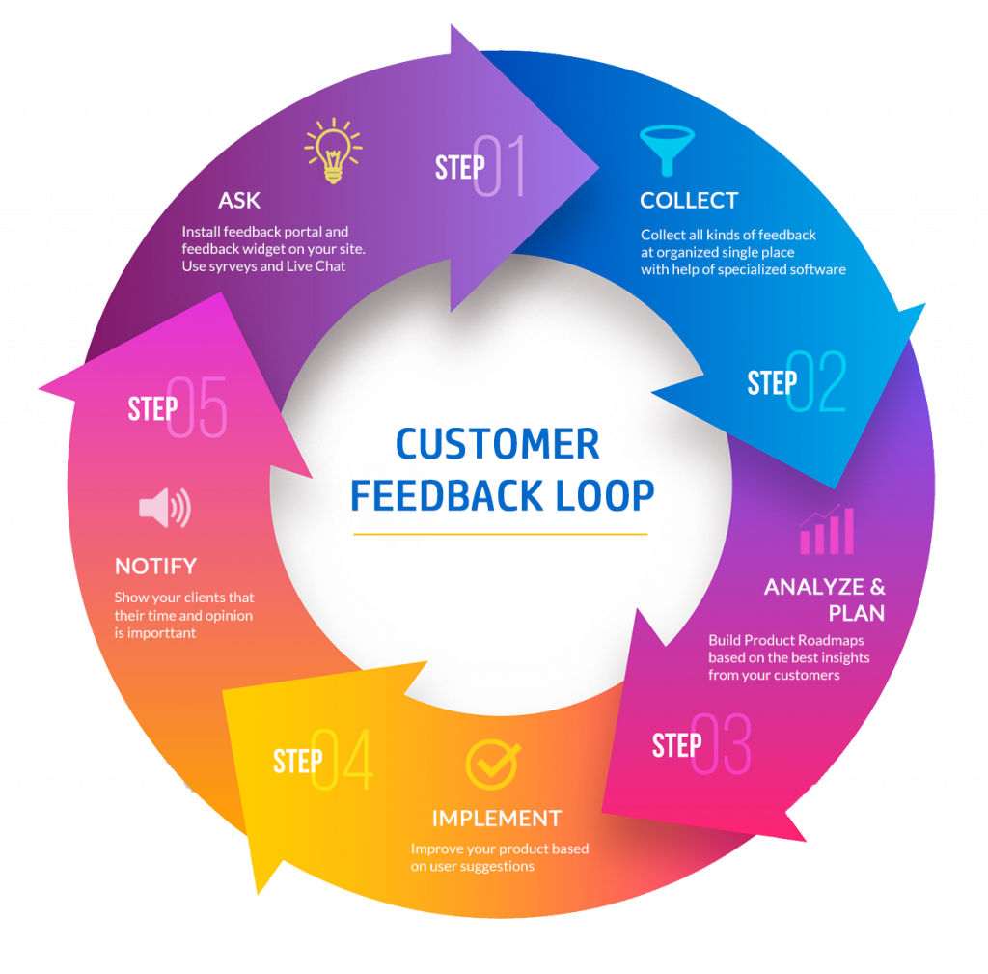
Continuous Improvement and Innovation in Customer Experience
Regularly gathering feedback from customers through surveys, reviews, and social media can help identify areas for improvement.
Testing new technologies and features to enhance the e-commerce experience, such as AR/VR for product visualization.
Keeping up with industry trends and competitors to stay ahead in providing exceptional customer experiences.
Notes:
Image source: https://www.deskera.com/blog/customer-feedback/

Slide 10

Measuring Success and ROI of Customer Experience Management
Key performance indicators (KPIs) such as customer satisfaction scores, Net Promoter Score (NPS), and customer retention rates help measure the effectiveness of customer experience management efforts.
Analyzing the impact of customer experience initiatives on revenue, repeat purchases, and customer lifetime value provides insights into ROI.
Benchmarking against industry standards and best practices can help e-commerce businesses assess their performance and identify areas for improvement.
Notes:
Image source: https://www.slidemake.com

Slide 11
Conclusion and Key Takeaways
Customer experience management is a critical factor in the success of e-commerce businesses, impacting customer loyalty, retention, and revenue growth.
By focusing on understanding customer needs, personalizing the shopping experience, and providing excellent customer service, e-commerce businesses can differentiate themselves in a competitive market.
Continuous improvement, innovation, and data-driven decision-making are essential for e-commerce businesses to deliver exceptional customer experiences and achieve long-term success.
Notes:
Image source: https://www.slidemake.com

Slide 12


